Slide 1
Online Pet Store
One Stop Shop For Your Pawbuddy!!!

Slide 2
Table Of Contents
Team Details
Problem Statement
Proposed System
Objectives
Canvas

Slide 3
Team Details
Dhara Chauhan
Enrollment No. : 210280107509
Tanvi Jain
Enrollment No. : 210280107536
Guided By : Prof. Hitesh Rajput
Team ID: - 353393
Semester – III Division – C
Design Engineering I A (3130008)

Slide 4
01
Problem Statement

Slide 5

Problem Statement
The fast growing lifestyle and the challenging times that the world is facing today where it has become jeopardous to step out of our homes has routed us all to a new way of living – “The Online way of Living”.
From basic needs to extravagant luxurious everything is accessible on your fingertips.
But what we fail to realize is the fact that most of the applications in use today are human centric and very little attention is being paid to our beloved pets.
Also, the few applications already available for this purpose do not cater many functionalities.
And so, we are proud to present a system exclusively designed and dedicated to our “PAWBUDDIES”.

Slide 6
02
Proposed System

Slide 7
Proposed System
Online Pet Store System is designed to manage pets & all pet related services online. From buying/adopting pets to keeping a track of your pet’s daily checkups; everything you ask for your pet is performed here in a systematic manner.
This system is specially designed for pets and focuses on every aspect related to them to help pet owners take care of their “paw-buddies” in a better way.
Pet owners only need to register their pets, and they are all set to use this system!
Users can search for pets nearby to buy or adopt them by setting filters based on breeds, age & gender.
Pet owners can buy pet products like their food & treats, toys, cage, clothes, accessories and a lot more at a single spot.

Slide 8
Proposed System
Every time pet owners buy pet products they get equivalent credit points according to which complementary gifts will be sent for their pawbuds!
Users can search for FAQ’s about pets & also chat with certified veterinary doctors.
Recommendations of books & movies based on pets and activities to do with your pets are also provided.
Users can also search for nearby pet hospitals, pet grooming spas & public places that allow pets and also get their contact details.
They can also set up reminders for important events like pet’s vaccine dates and checkups, pet’s grooming session & all other pet related events.
A special corner is also provided that caters also basic information about pets of various breeds to help pet owners understand their pets better.

Slide 9

Buy/adopt Pets
Recommendations
Buy Pet Products
Set Reminders
FAQ’s & Chat with Vets
Search nearby pet places

Slide 10
03
Objectives

Slide 11
Objectives
As now a days every thing is moving to the digital world because digital is faster than manual things, saves time and man efforts.
The main objective of pet store is to buy all pet accessories and adopt the pets in the efficient way and the aim is to communicate the doctors faster than the traditional manner.
Providing every necessary things to the owner to keep their pets happy and healthy, for instance- related movies, books, FAQ’s about pets & also chat with certified veterinary doctors, A special corner is also provided about pets of various breeds to help pet owners understand their pets better, to donate to the animal culture, their food and habitats.

Slide 12
04
Canvas

Slide 13
04.1
AEIOU Framework

Slide 14
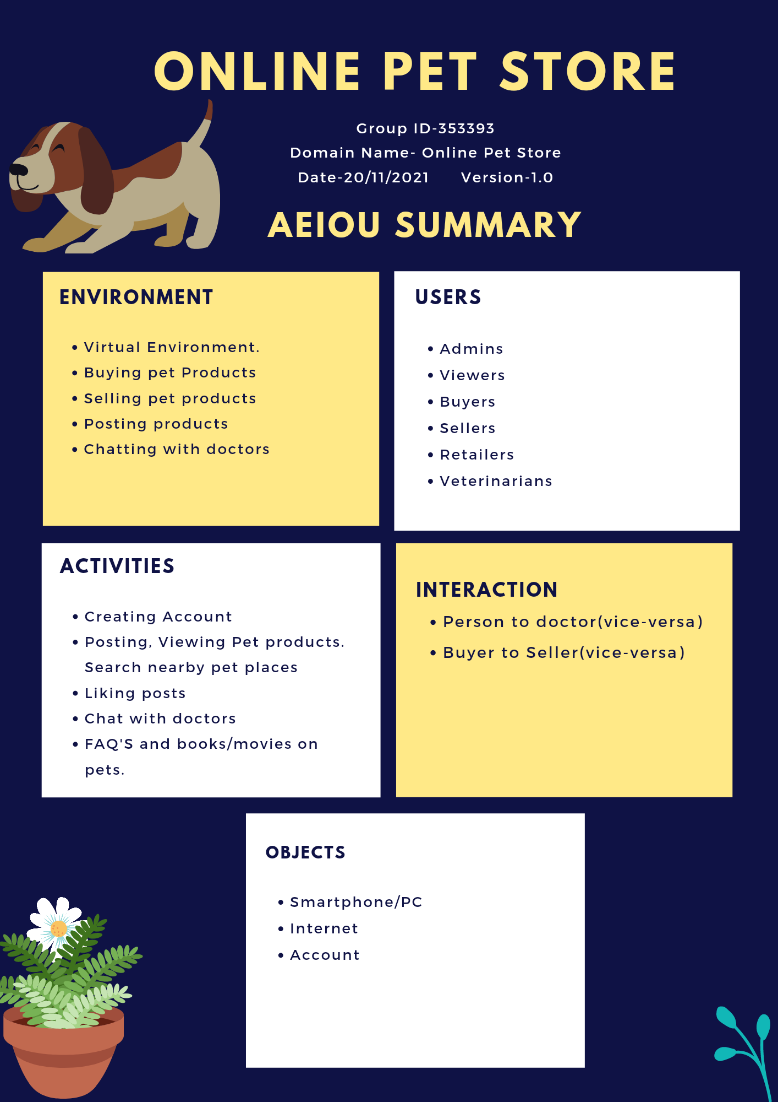

Slide 15
04.2
Mind Map

Slide 16
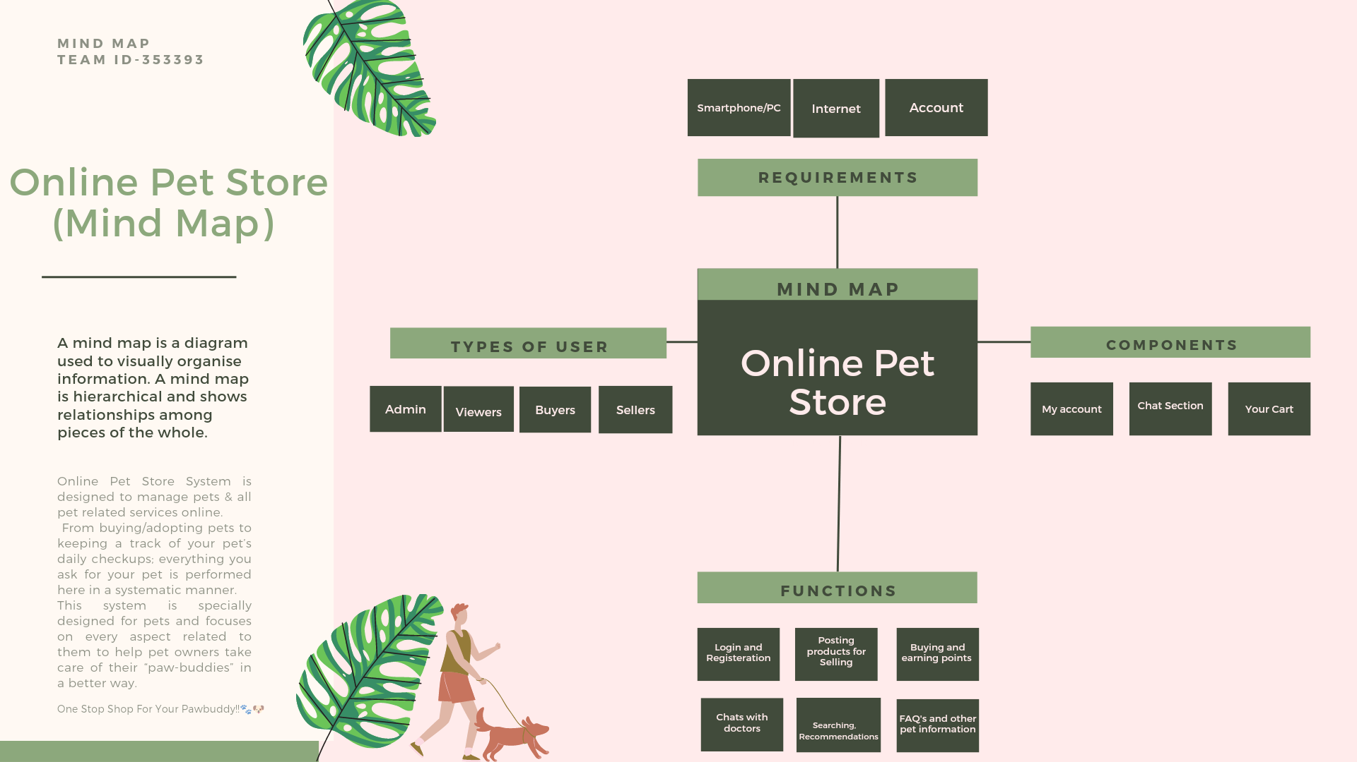

Slide 17
04.3
Empathy Map

Slide 18
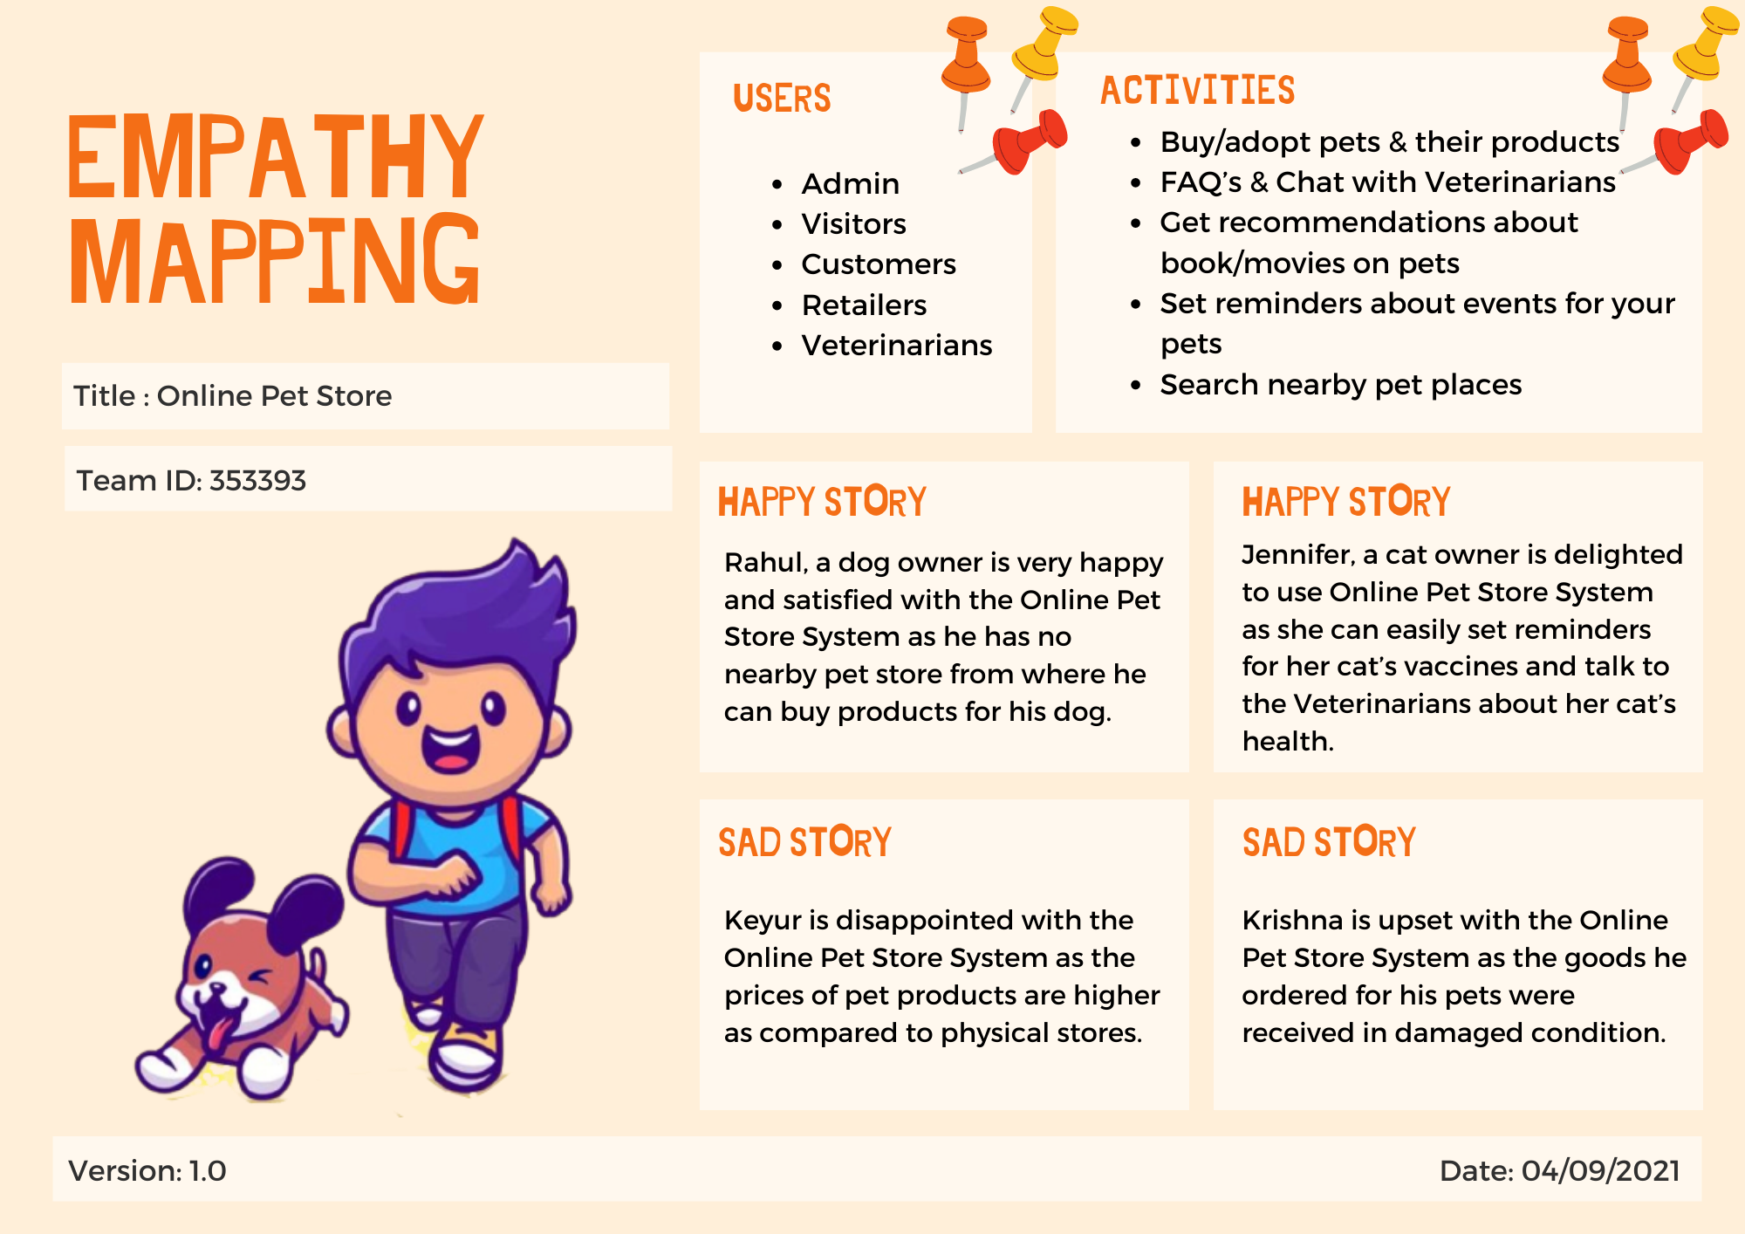

Slide 19
04.4
Ideation Canvas

Slide 20
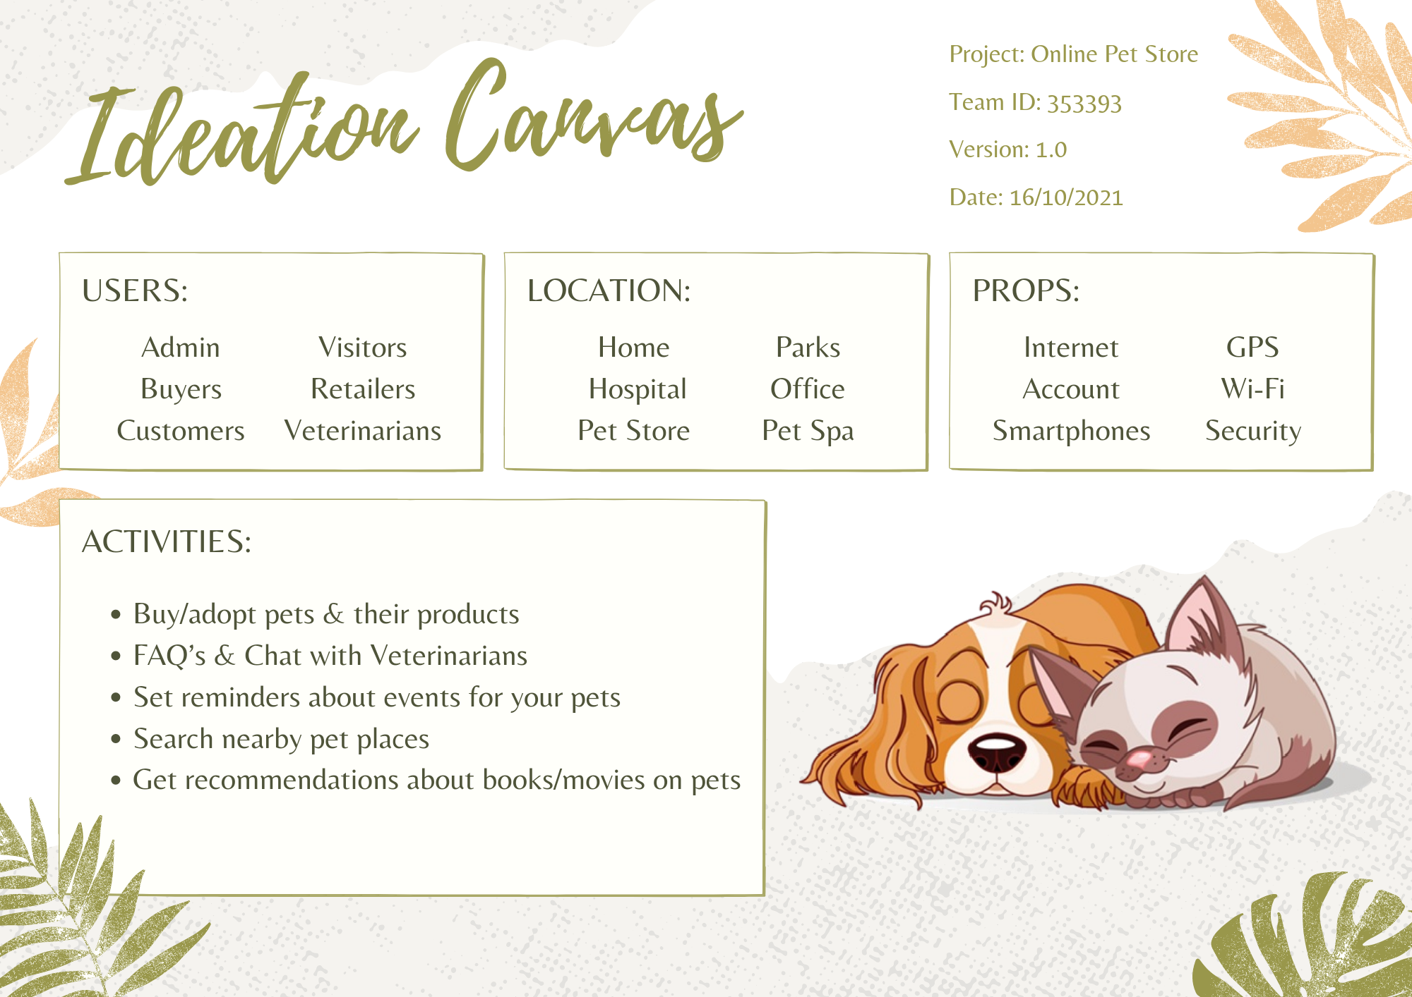

Slide 21
04.5
Product Development Canvas

Slide 22
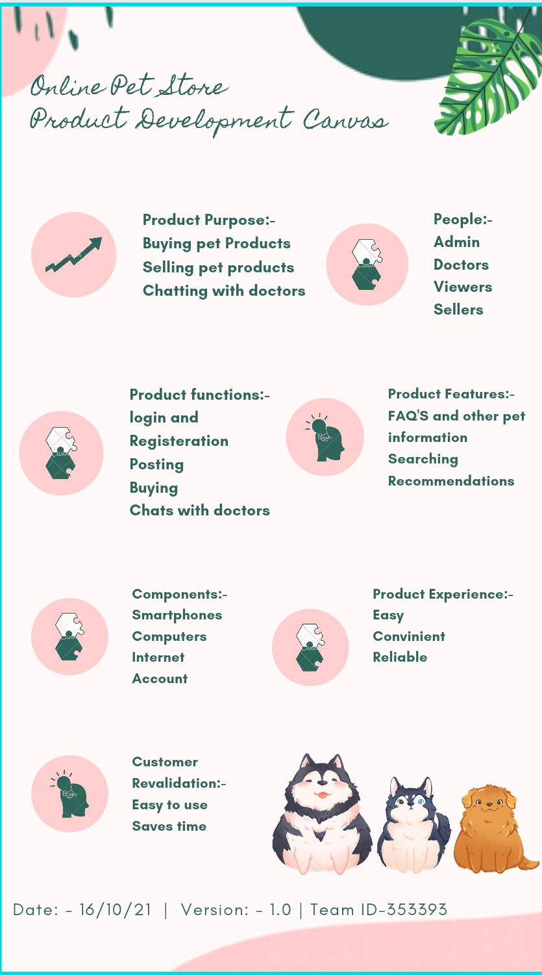

Slide 23
04.6
Learning Need Matrix

Slide 24
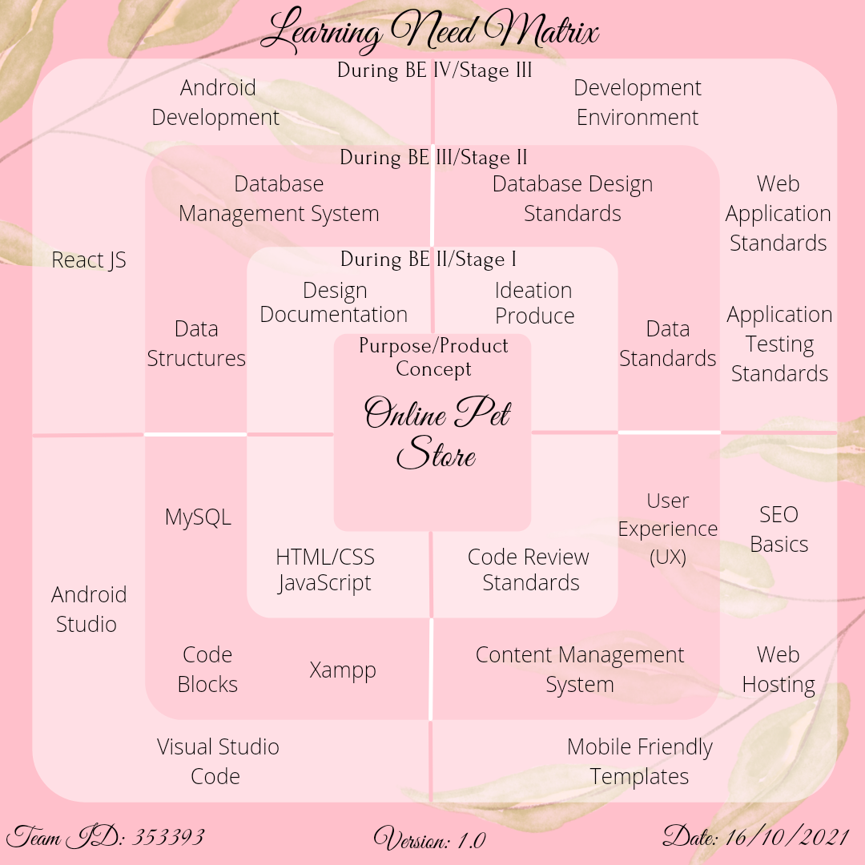

Slide 25
04.7
Rough Prototype

Slide 26
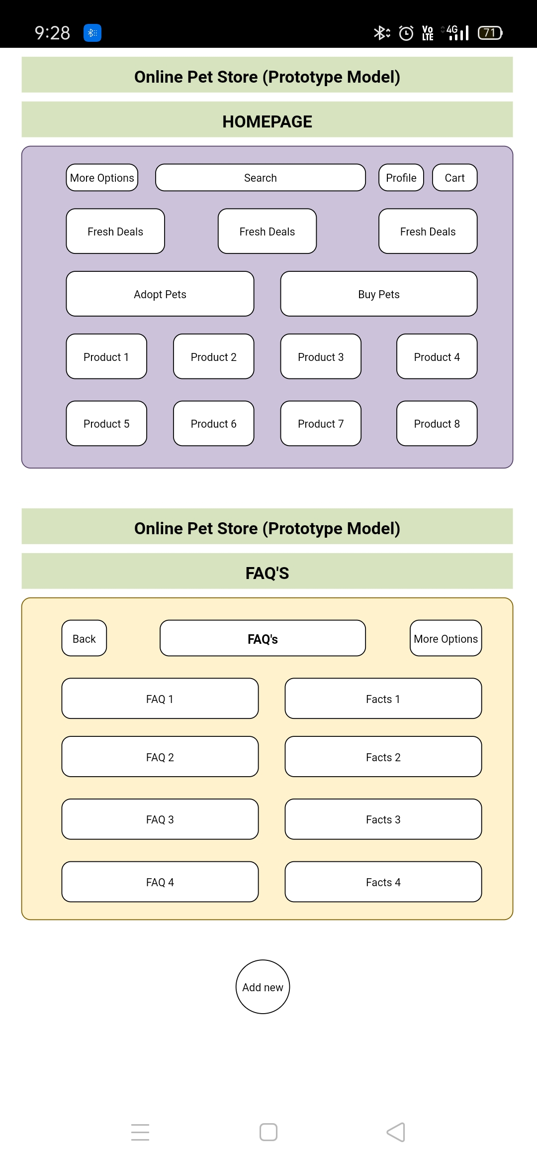
Watch These Trendy ARTS!!

Slide 28
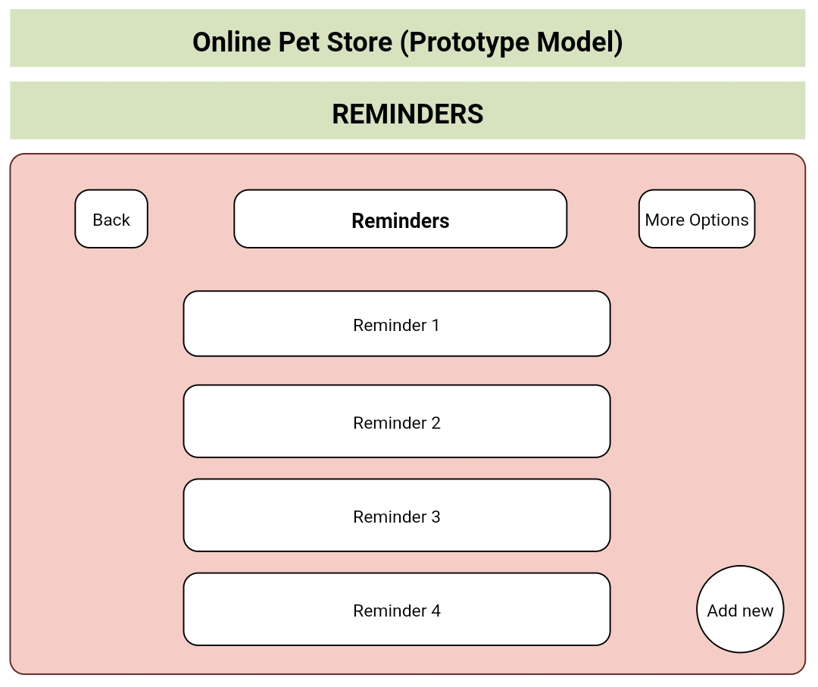

Slide 29
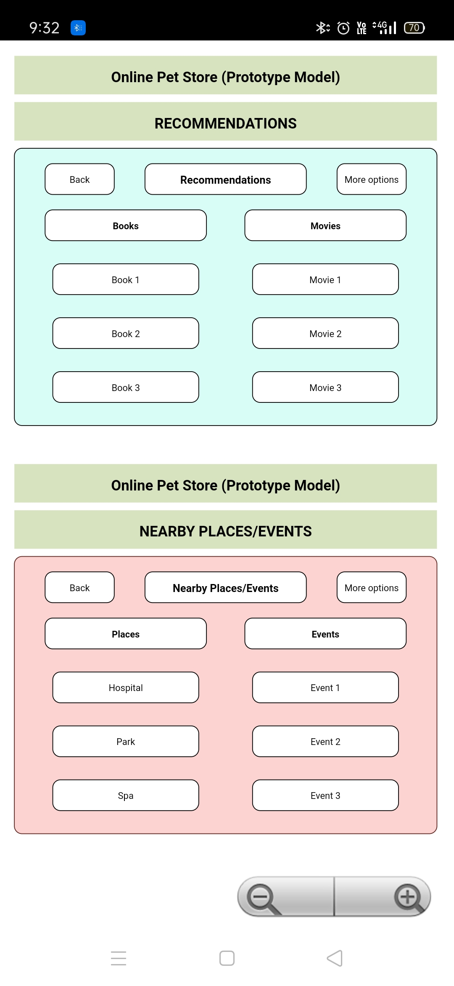

Slide 31
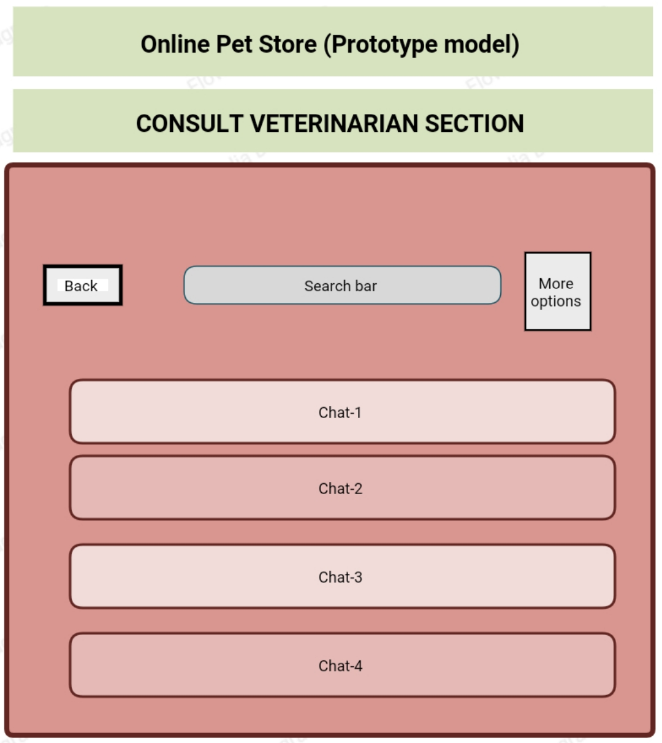

Slide 32
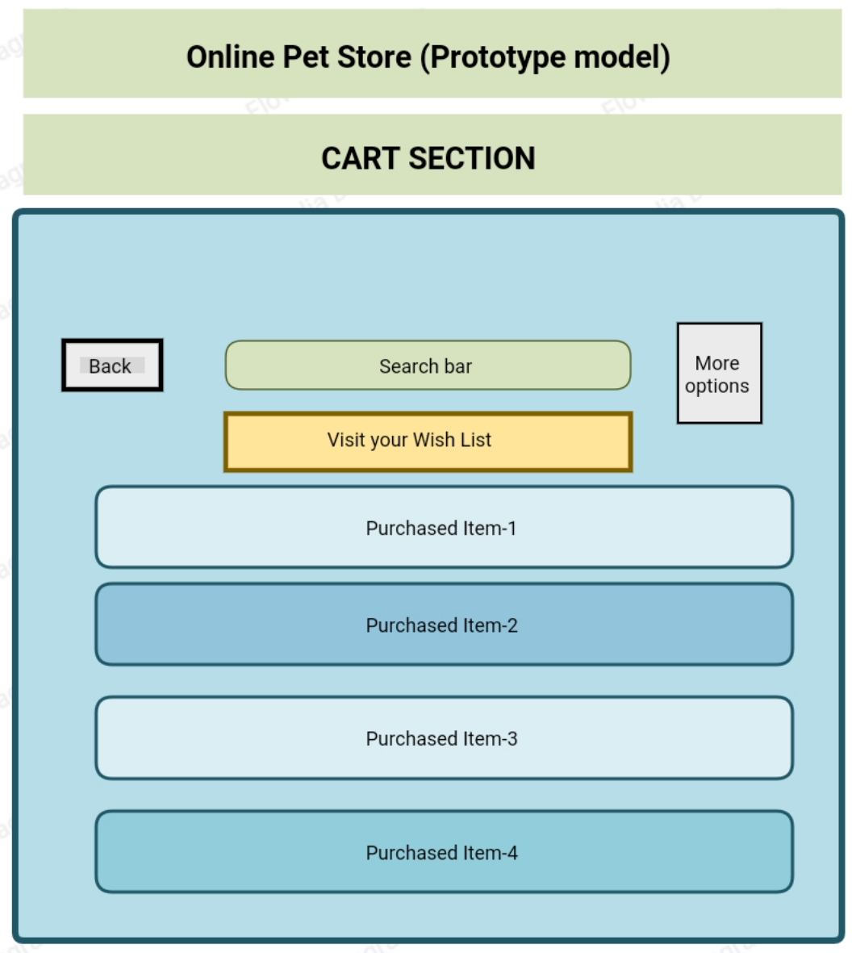

Slide 33
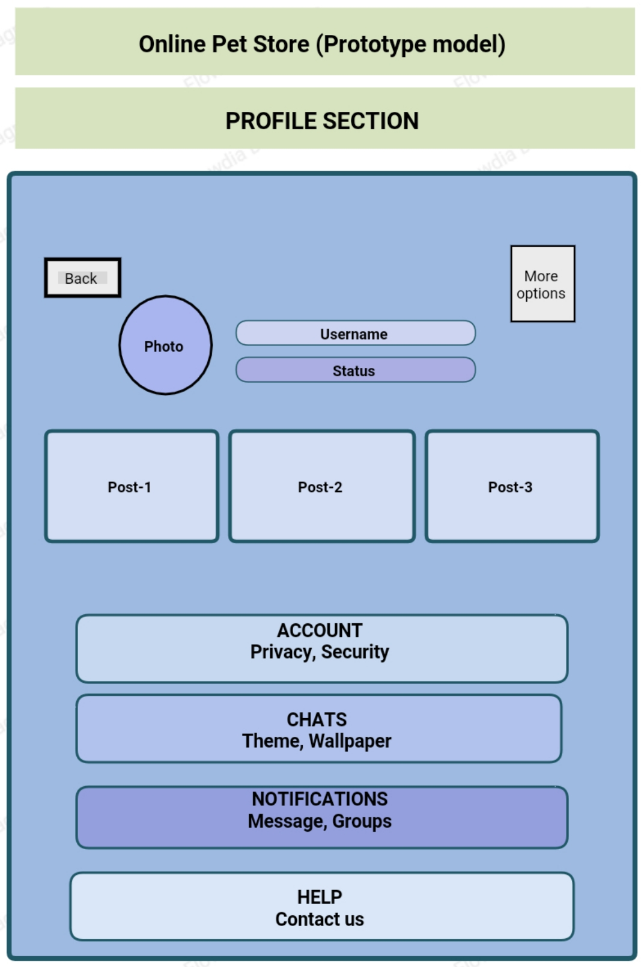

Slide 34
Thank You!!!

